Slide 1
Population Stability
Annie Walsh

Slide 2
Introduction
Yellowstone in the 1930s
Hunters killed a large number of wolves to protect livestock and trophy animals such as elk
This lead to a decreased death rate of elk
The higher elk population lead to an overgrazing of plants such as willows
With fewer resources, the elk and other populations suffered

Slide 3
What I’ll be Modeling
Using a system of two equations is easier to manipulate but slightly less accurate
Lotka-Volterra equations to model plant and prey populations
Predator population will be a constant
Populations will be in thousands
How will a decreased predator population impact a system?

Slide 4
Baseline System
No Human Interference

Slide 5
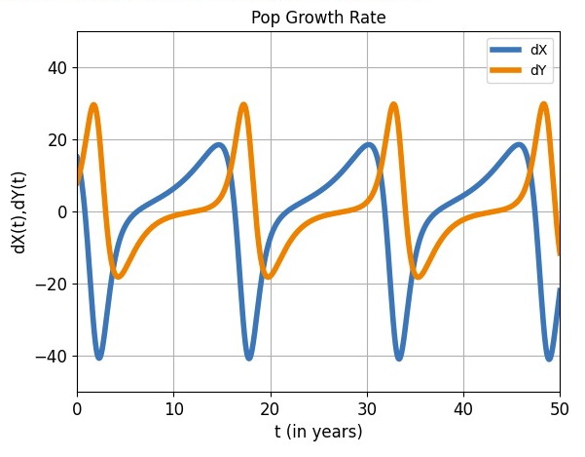
Equations
Plant (x):
dxdt=.3X-.015XY
birth rate - death rate
Prey (y):
dydt=.015XY–.2Y-5(Z)Y
birth rate - non predatory death rate - predatory death rate
Predator (Z):
starting with baseline population of Z=.1 (100 predators)

Slide 6
Finding Equilibria

Slide 7
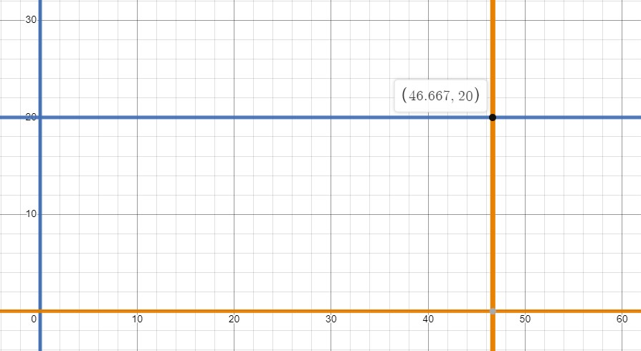
Nullclines
X-nullclines
X-nullclines:
x=0 y=20
Y-nullclines:
y=0 x=13.33+333.33Z
Non zero equilibria:
(46.67, 20)
Y-nullclines

Slide 8
Stability
.3 -.015y | -.015x
.015y | .015x -.7
Stability:
.3 -.015y | -.015x
.015y | .015x -.7
Jacobian matrix:
J(46.67, 20):
det(J)=.21
trace(J)=0
Spiral
0 | -.7
.3 | .0

Slide 9
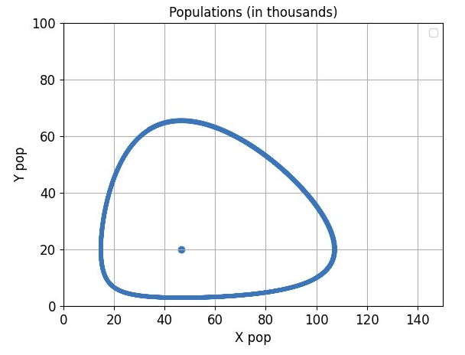
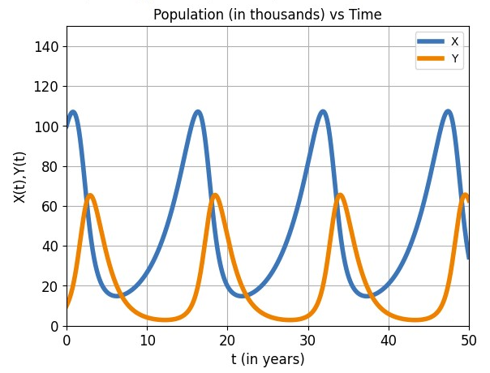
Integrated Systems
Parameters: x0=100, y0=10

Slide 10
Manipulated System
Humans Killing off Predator Population

Slide 11
Equations
dxdt=.3X-.015XY
dydt=.015XY–.2Y-5(Z)Y
0<Z<.1
Z=0 : Humans are taking away all of predator population
Z=.1 : Humans are taking away none of predator population

Slide 12
Finding Equilibria

Slide 13
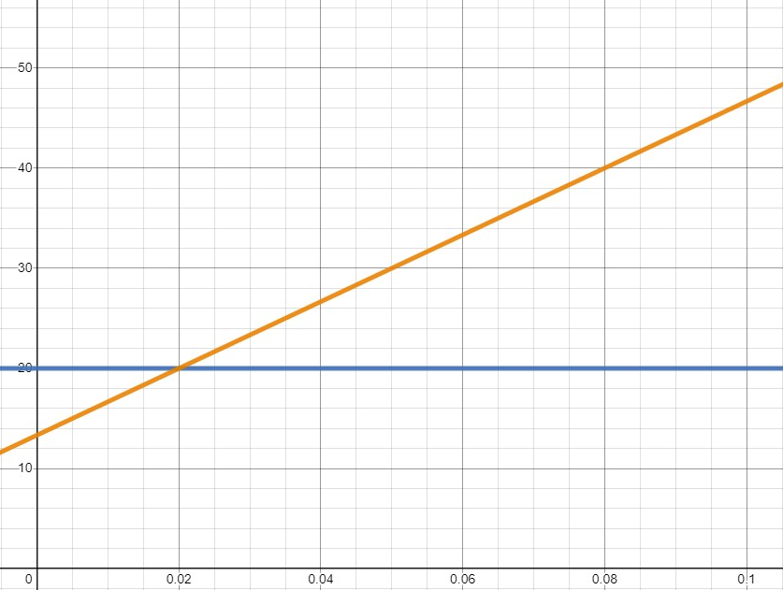
Equilibria
X-nullclines:
x=0 y=20
Y-nullclines:
y=0 x=13.33+333.33Z
Non zero equilibria:
(13.33+333.33Z, 20)
X, Y coordinates of equilibria
Z-Value

Slide 14
Stability
.3 -.015y | -.015x
.015y | .015x -5z -.2
Stability:
Jacobian matrix:
J(13.33+ 333.33Z, 20):
det(J)=.06+1.5z
trace(J)=0
Spiral
0 | -.2 -5Z
.3 | 0

Slide 15
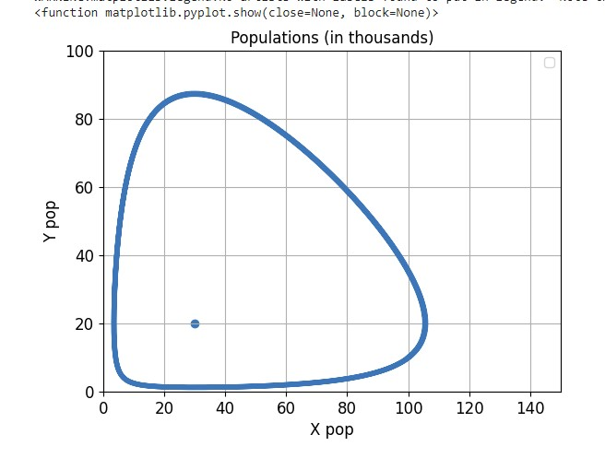
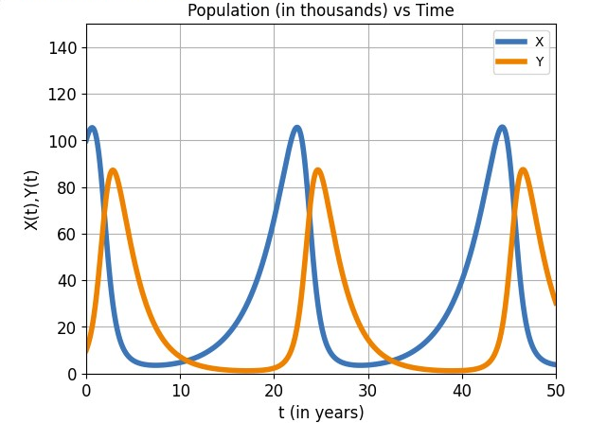
Integrated Examples
Z=.05
Parameters: x0=100, y0=10

Slide 16
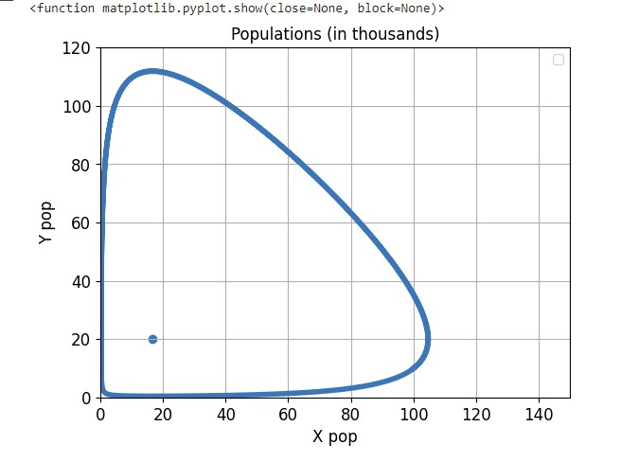
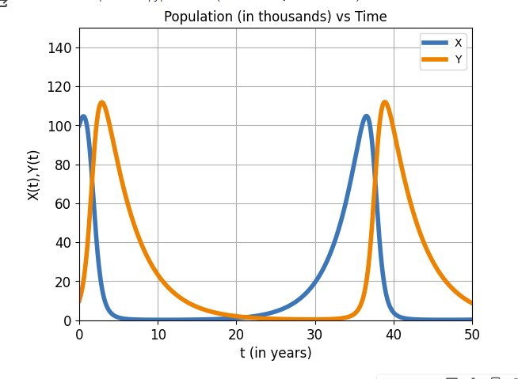
Integrated Examples
Z=0
Parameters: x0=100, y0=10

Slide 17
Results
z=.1
Removing the predator population in this system does not lead to the extinction of the other populations
The minimum plant and prey population are much lower
Less stable ecosystem
Longer “recovery” period
If either population does reach zero, the population will not be able to naturally recover
z=0

Slide 18
Works Cited
https://www.nps.gov/yell/learn/nature/wolf-restoration.htm
https://algebraicjulia.github.io/AlgebraicDynamics.jl/dev/examples/Lotka-Volterra/

